Slide 1
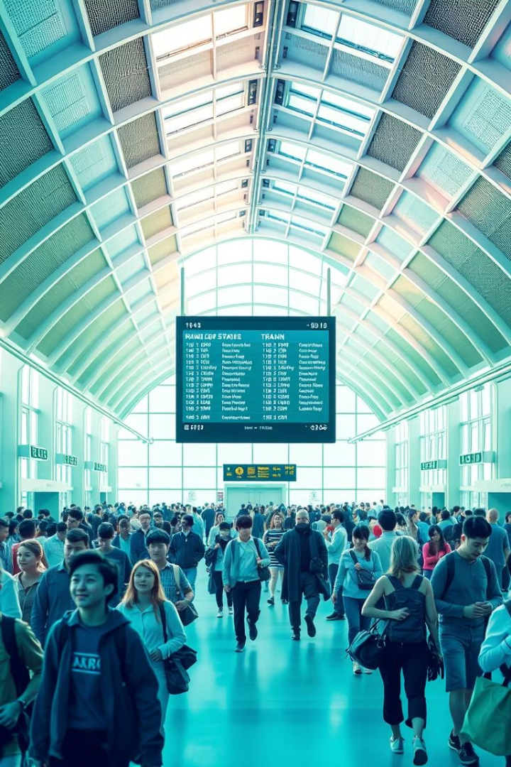
Online Railway Registration System
Welcome to the online railway registration system, a comprehensive platform designed to streamline your railway journey.
Done by
N . Samith (192210612)
N . Sandhya(192211906)

Slide 2
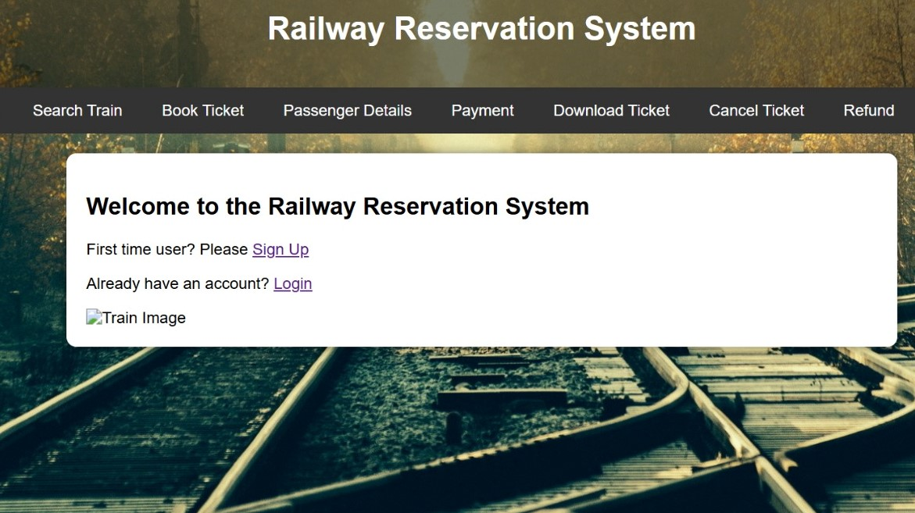
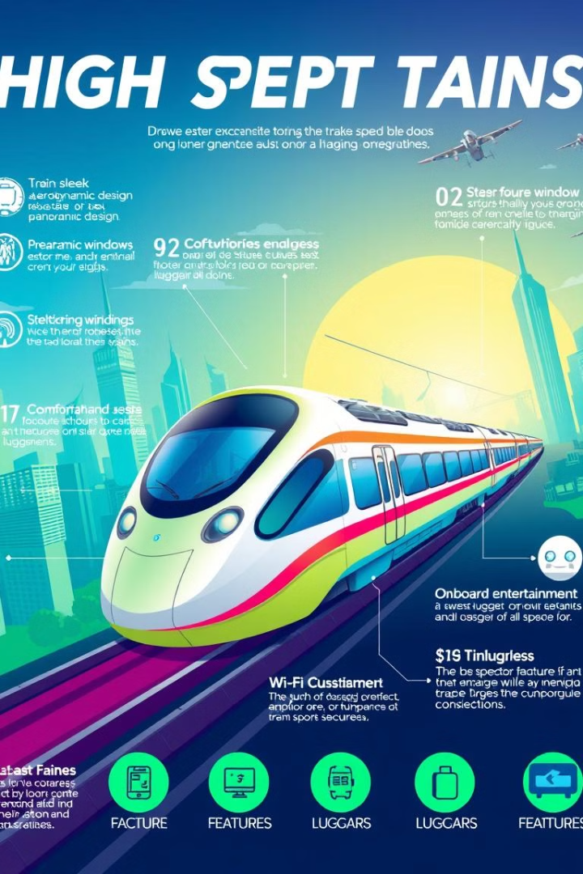
Key Features of the System
1
User-Friendly Interface
2
Real-Time Information
The system boasts an intuitive interface that makes it easy for users to navigate and access information. The platform provides clear instructions and guides throughout the process, ensuring a smooth and enjoyable experience.
Stay informed with real-time updates on train schedules, delays, and cancellations. The system provides instant access to critical information, allowing for informed decisions and reducing travel anxiety.
3
Secure Payment Gateway
4
Comprehensive Support
The system provides comprehensive support through a questions about registration, bookings, or payments, assistance is readily available. dedicated help center, FAQs, and customer service. Whether you have
The platform offers secure payment options, enabling you to purchase tickets with peace of mind. The system employs industry-standard security protocols to protect your financial data.

Slide 3
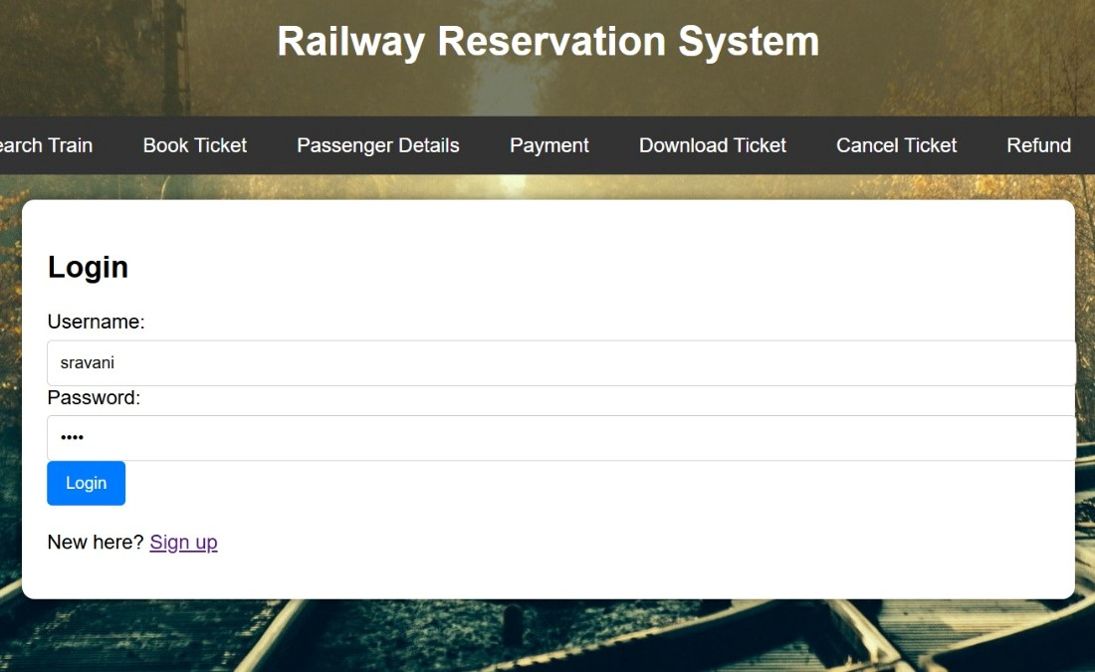
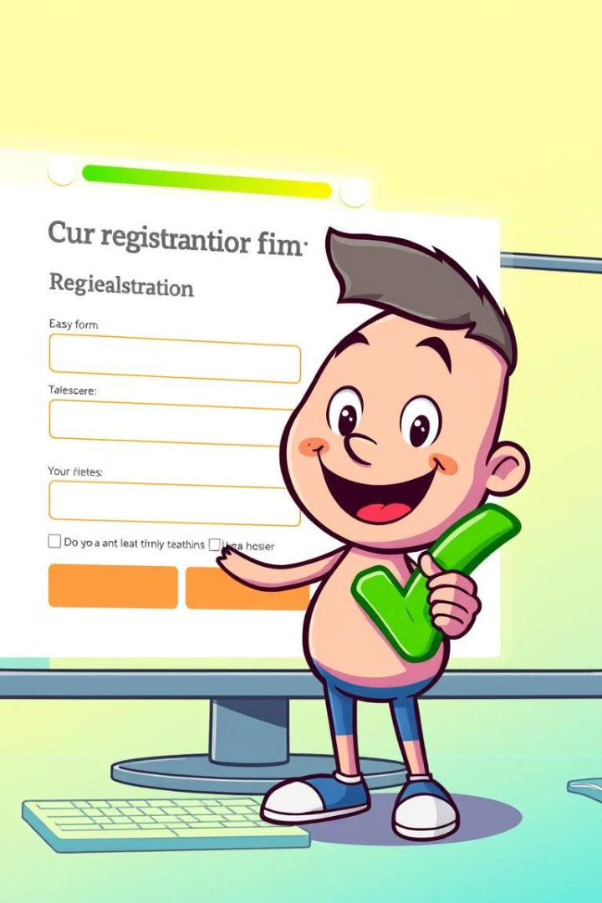
User Registration and Login
1
Create Account
New users can create an account by providing basic personal information, including name, email address, and contact details. The system securely stores this data.
2
Login Credentials
Once registered, users can access the system using their unique login credentials. This ensures secure access and personalized user experiences.
3
Account Management
Users can manage their account settings, update profile information, and access previous bookings and travel history. The system provides a comprehensive overview of user activity.

Slide 4
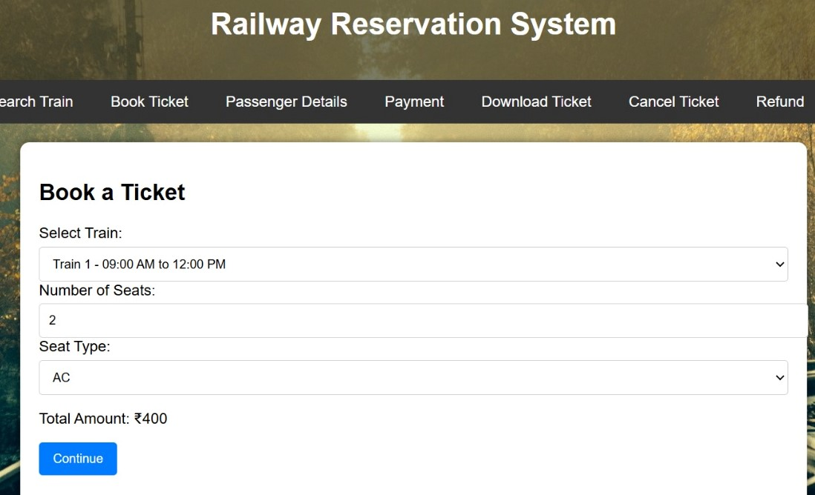
Ticket Booking and Reservation
Search for Trains
Seat Selection
Users can search for available trains based on departure and arrival cities, date of travel, and preferred class. The system presents a list of suitable options, including train details and pricing.
Upon selecting a train, users can choose their desired seats based on availability and preferences. The system provides a visual map of the train layout to facilitate selection.
Confirmation and Booking
Once the seats are selected, users confirm their booking and proceed with payment. The system generates a unique booking reference number for tracking purposes.

Slide 5
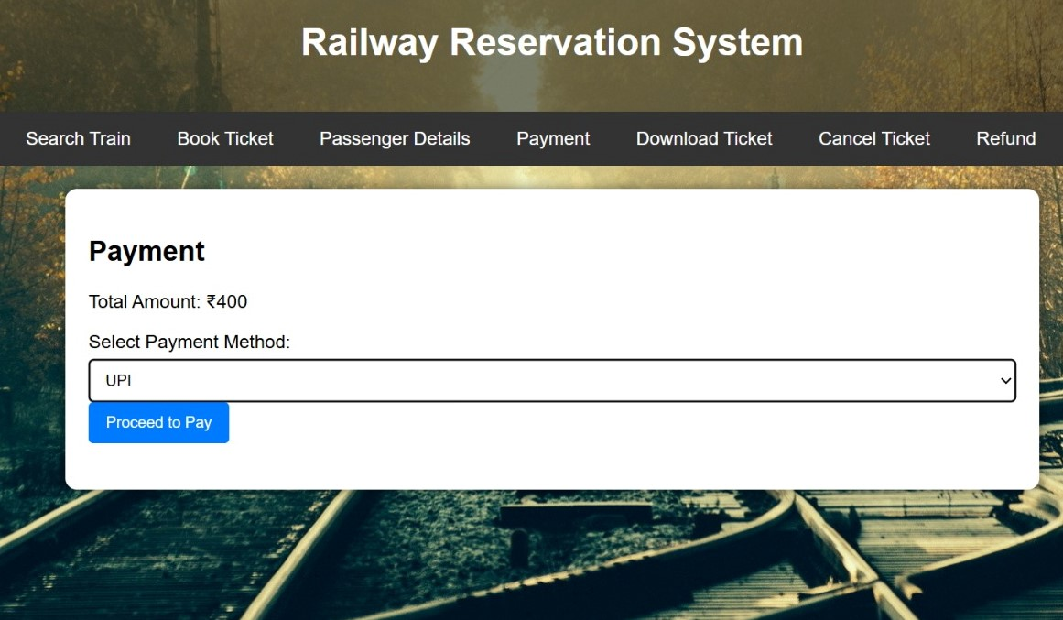


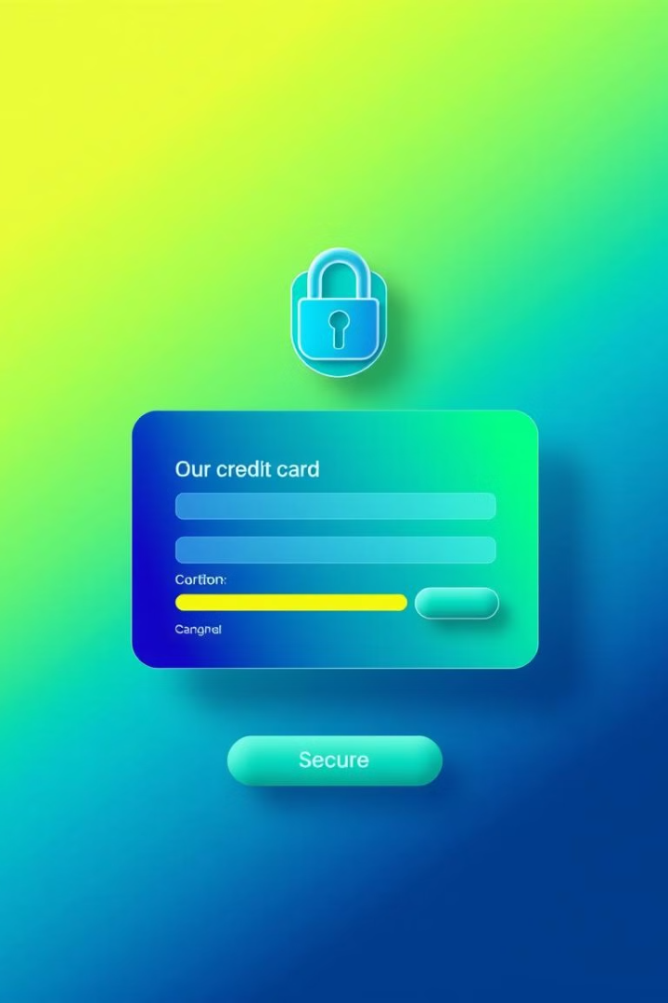

Payment Integration
Secure Payment Gateway
The system integrates with a secure and reliable payment gateway, providing users with a variety of payment options, including credit cards, debit cards, and mobile wallets.
Payment Processing
Once the user selects their payment method, the system securely processes the transaction, ensuring safe and efficient payment handling.
Payment Confirmation
Upon successful payment, the system provides a confirmation message and generates a receipt for the transaction. Users can access and download this receipt for future reference.

Slide 6
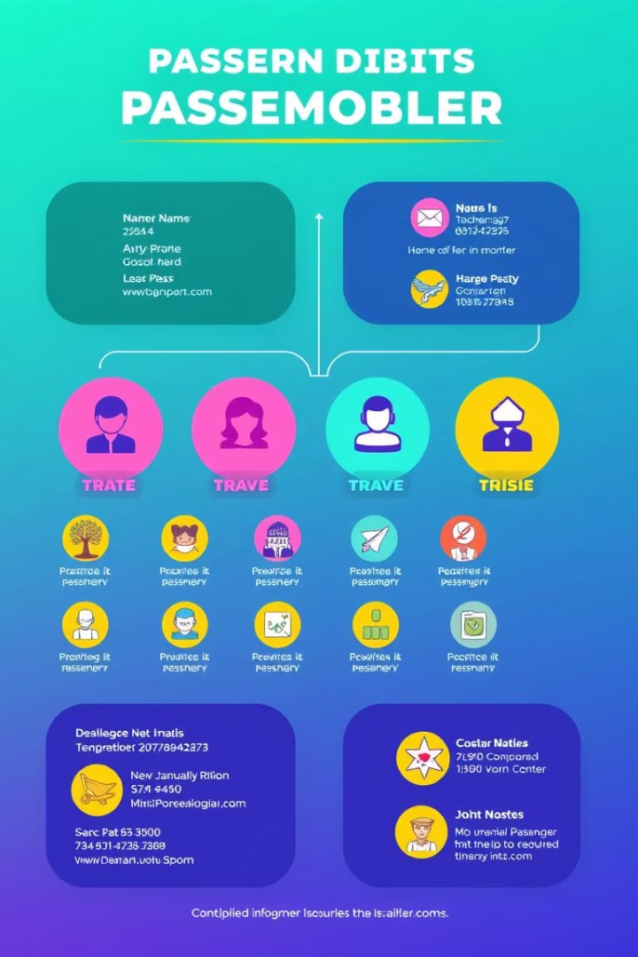
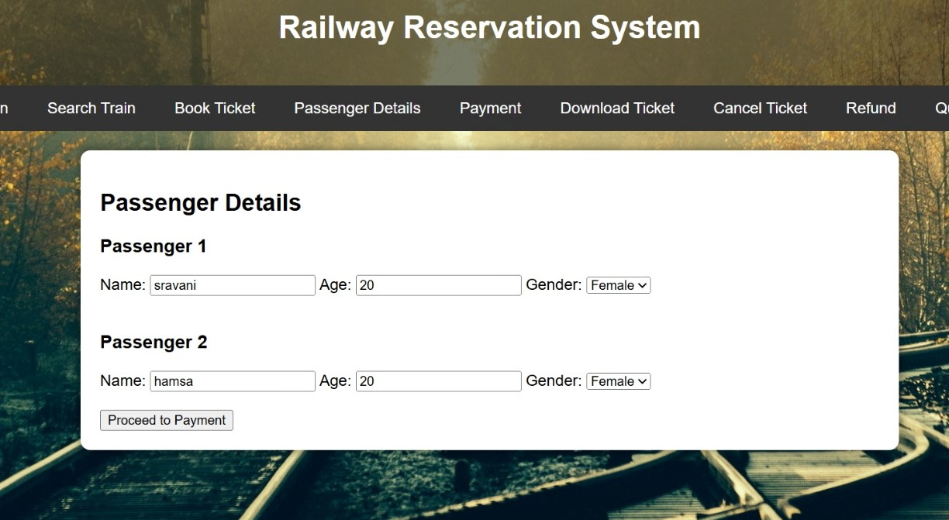
Passenger Information Management
Passenger Name
Contact Information
Ticket Details
Address
Emergency Contact
Booking Reference
Date of Birth
Travel History
Seat Number

Slide 7
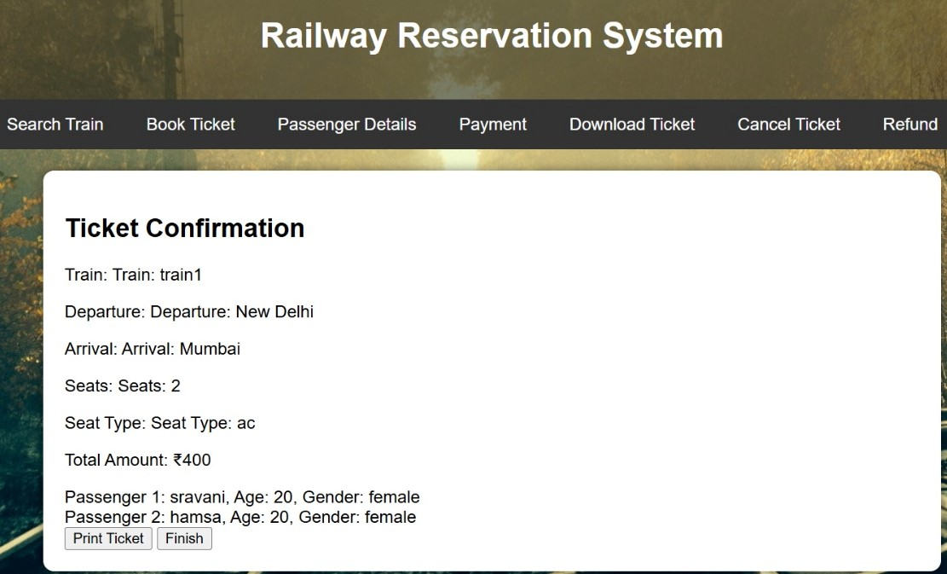
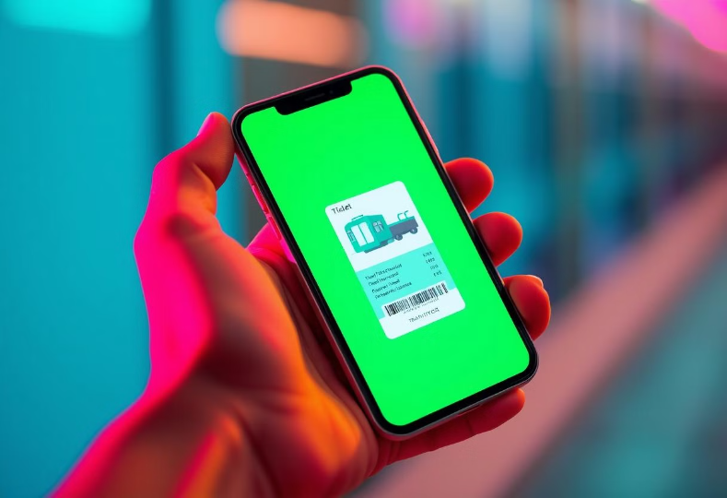
Ticket Download and Details
Users can easily download their tickets after completing the booking process. The system allows for multiple download formats, including PDF and mobile-friendly versions. Users can access their tickets through their account dashboard or receive them via email.
Each ticket includes essential travel details such as passenger information, booking reference number, train details, date and time of travel, and seat number. This comprehensive information ensures a smooth and hassle-free travel experience.

Slide 8
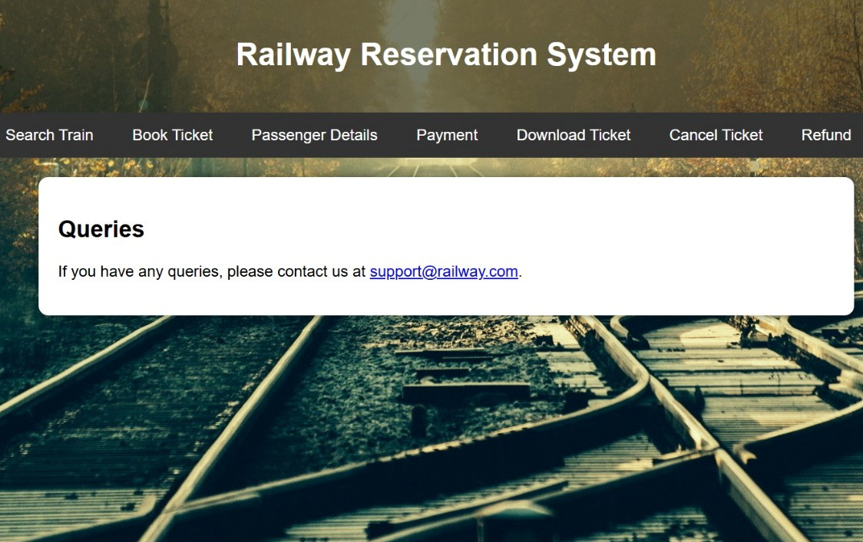

Queries
The online railway registration system provides a dedicated query section to address user inquiries. Users can submit questions about ticket bookings, payment methods, travel regulations, and other system-related issues. The system offers a variety of methods for submitting queries, including online forms, email, and live chat.
The system features a comprehensive knowledge base that provides answers to frequently asked questions (FAQs). Users can search the FAQs for quick and convenient solutions to common issues. In addition to FAQs, the system also provides a directory of contact information for customer support representatives.

Slide 9
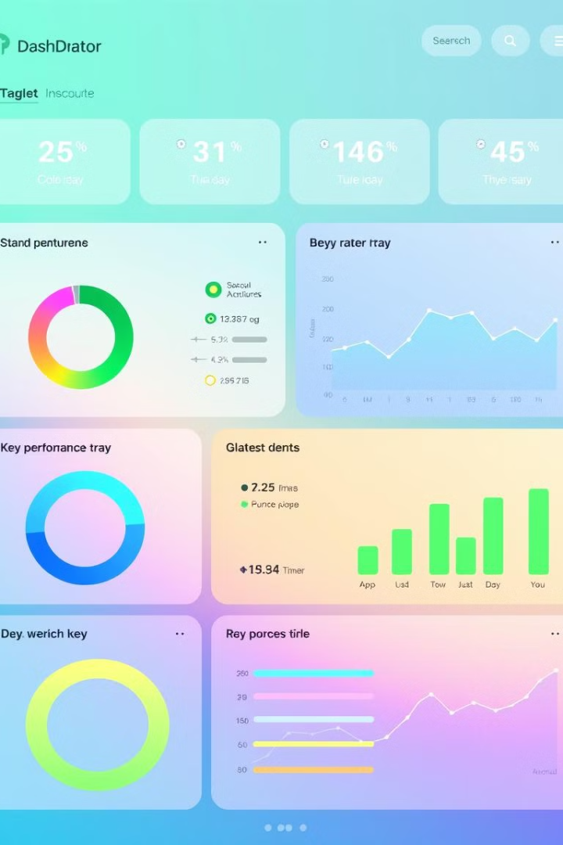



Reporting and Analytics
Booking Trends
The system provides detailed insights into booking trends, including popular routes, travel dates, and passenger demographics. This data helps optimize services and enhance customer experience.
Revenue Analysis
The system generates reports on revenue generated from ticket sales, enabling the railway authorities to track profitability, identify peak seasons, and plan future strategies.
Customer Feedback
The system gathers and analyzes customer feedback to identify areas for improvement and enhance user satisfaction. This data helps ensure a positive and seamless travel experience.

Slide 10
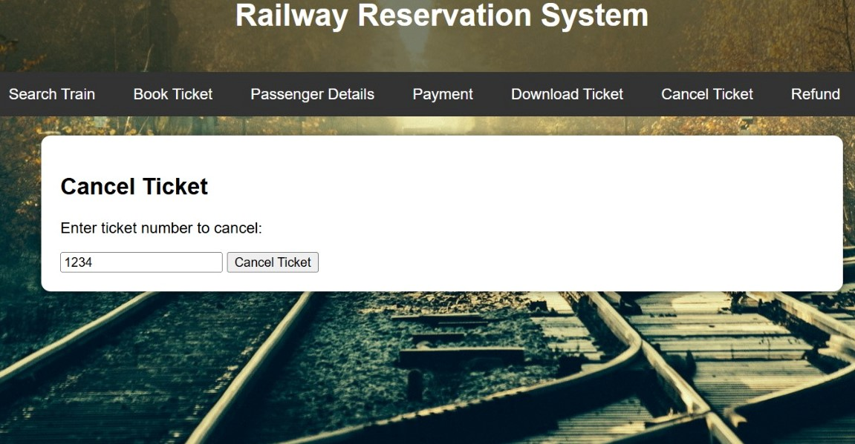
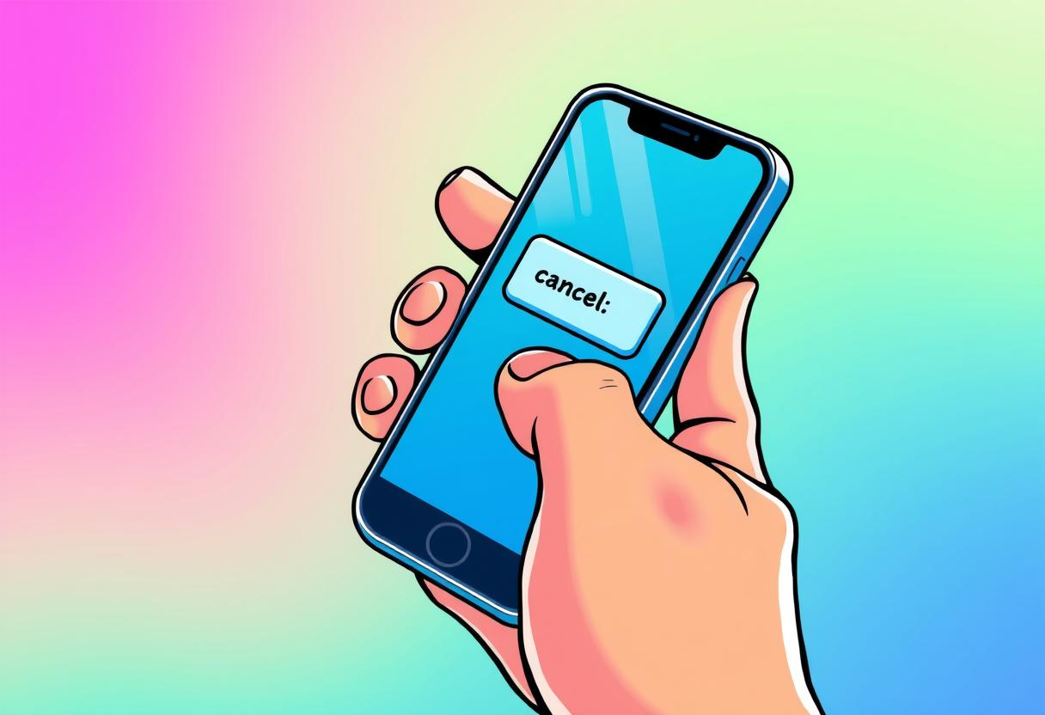
Ticket Cancellation
Users can easily cancel their tickets through the system. They can initiate a cancellation request through their account dashboard or by contacting customer support.
Upon cancellation, the system will process the refund according to the refund policy.
The refund policy specifies the percentage of the ticket amount that will be refunded based on the time of cancellation.

Slide 11
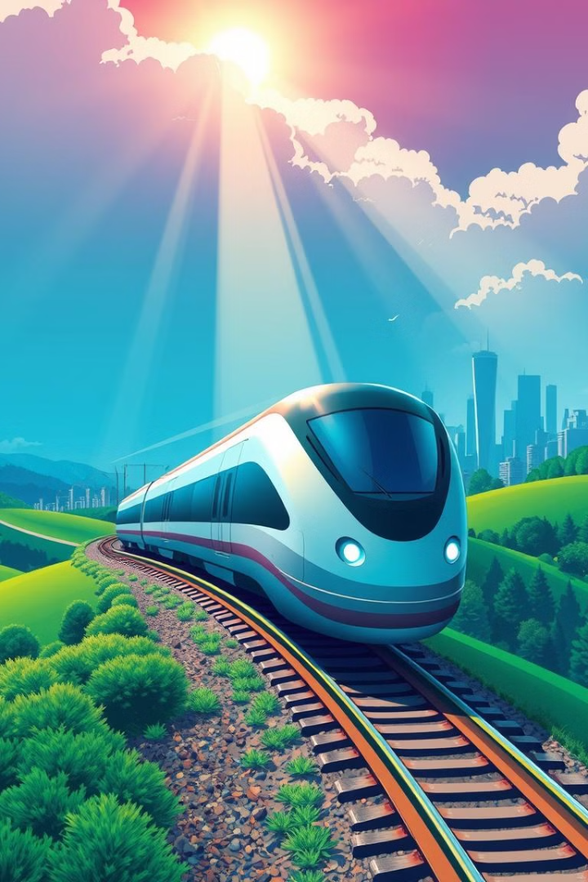
Conclusion and Future Enhancements
Modernization
Future Enhancements
The online railway registration system provides a modern and efficient approach to managing railway services, revolutionizing the travel experience and empowering users with greater control and convenience.
Continuous improvement is key. Future enhancements include integrating mobile applications, providing real-time tracking of trains, and personalized travel recommendations.

Slide 12


